Slide 1
Data: Abstraction, Independence, & Modeling

Slide 2
Data Abstraction
Why it is Important?
How is it provided by a DBMS?
3 levels of abstraction
  Physical or Internal Level
  Logical Level
  View or External Level

Slide 3
Data Independence
What is Data Independence?
Why is it Important?
How is it provided by a DBMS?
Types of Independence
  Physical Data Independence
  Logical Data Independence

Slide 4
Data Modeling
What is Data Modeling?
An integrated collection of concepts for describing & manipulating data, relationships between data, & constraints on the data in an organization
Used for defining Database Schemas
Databases have several schemas, partitioned according to levels of abstraction
Schema Levels
  Physical Schema
  Conceptual/Logical Schema
  Sub-schemas or external schemas

Slide 5
Data Model
A data model in software engineering is an abstract model that describes how data is represented and accessed
Data models formally define data elements and relationships among data elements for a domain of interest
If different data models are used for describing different systems, complex interfaces are required to share data among them

Slide 6
Popular Data Models
Entity-Relationship Model
Relational Model
Hierarchical Model
Network Model
Inverted File Model
Object-Oriented Model
Object-Relational Model

Slide 7
Data Abstraction
Major aim of a DBMS is to provide users with an abstract view of data
Hides certain details of how the data are stored & maintained
DBMS must retrieve data efficiently
Need for efficiency has led designers to use complex data structures to represent the data in the database
Most DB users are not computer trained, developers hide complexity through several levels of abstraction to simplify user’s interaction with the systems

Slide 8
3 Levels of Abstraction
Physical or Internal Level
  Lowest level of abstraction describes how data are actually stored
  Describes complex low-level data structures in detail
Logical or Conceptual Level
  Describes what data are stored in the DB & what relationships exist among those data
  Describes the entire DB in terms of relatively simpler structures
View or External Level
  Highest level of abstraction which describes only a part of the DB
  User’s view of the DB. This level describes part of the DB that is relevant to each user

Slide 9
3 Levels of Abstraction
Logical or Conceptual Level
  Describes what data are stored in the DB & what relationships exist among those data
  Describes the entire DB in terms of relatively simpler structures
  Implementation of these simple structures at this level may involve complex physical-level structures
  Users of the logical level need not be aware of this complexity
  DBAs, who decide what information to keep in DB, use the logical level of abstraction

Slide 10

Levels of Abstraction (1)

Slide 11
Levels of Abstraction (2)
Many views, single conceptual (logical) schema and physical schema
  Views describe how users see the data
  Conceptual schema defines logical structure
  Physical schema describes the files and indexes used
Schemas are defined using DDL, data is modified/queried using DML

Slide 12
ANSI/SPARC 3-Tier Architecture (1)
Proposal for standard terminology & general architecture for DBSs produced in 1971 by DBTG (Data Base Task Group) appointed by Conference on DBSs & Languages (CODASYL)
DBTG recognized the need for a 2-tier architecture with system view (schema) & user view (subschema)
ANSI (American National Standards Institute)-SPARC (Standards Planning & Requirements Committee) produced similar terminology & architecture in 1975(ANSI/X3/SPARC)* in 1975
ANSI-SPARC recognized the need for a 3-tier architecture
*ANSI/X3/SPARC study group on DBMSs. Interim Report, FDT. ACM SIGMOD Bulletin,
7(2), 1975.

Slide 13
ANSI/SPARC 3-Tier Architecture (2)
User 1
User 2
User n
External Level
View 1
View 2
…
View n
E/C Mapping
Logical DI
Conceptual/Logical Level
Conceptual Schema
Physical DI
C/I Mapping
Internal Level
Physical Schema
Database

Slide 14
Levels of Abstraction
Many views, single conceptual (logical) schema and physical schema
  Views describe how users see the data
  Conceptual schema defines logical structure
  Physical schema describes the files and indexes used
Schemas are defined using DDL, data is modified/queried using DML

Slide 15
Internal Level
space allocation, data compression, encryption, access paths
DBMS: Data access optimized and storage minimized

Slide 16
ANSI-SPARC Architecture (3)
Separates users’ view from the way in which the data is arranged physically or logically
It hides the physical storage details from users: Users should not have to deal with physical database storage details. They should be allowed to work with the data itself, without concern for how it is physically stored
The database administrator should be able to change the database storage structures without affecting the users’ views : From time to time changes to the structure of an organisation’s data will be required.
The internal structure of the database should be unaffected by changes to the physical aspects of the storage : For example, a changeover to a new disk.

Slide 17
ANSI-SPARC Architecture (3)
The database administrator should be able to change the conceptual or global structure of the database without affecting the users : This should be possible while still maintaining the desired individual users’ views.
Implementation of architecture using SQL updateable views was done in 1998 which uses triggers

Slide 18
Instances & Schemas (1)
Collection of information stored in the DB at a particular moment is called an INSTANCE
The overall design of the DB is called a SCHEMA
A DB has many schemas
  Physical
  Conceptual/Logical
  Sub-schemas
DB design with requirements analysis
Requirements of individual users are integrated into a single community view, called “conceptual schema”
Represents “entities”, their “attributes”, & their “relationships”

Slide 19
Instances & Schemas (2)
Conceptual design is independent of the DBMS, application programs, & physical considerations
Conceptual schema is translated into a schema that is compatible with the chosen DBMS
Relationships between entities as reflected in the conceptual schema may not be implementable with the chosen DBMS
Version of the conceptual schema that can be presented to the DBMS is called the “Logical Schema”
In a RDBMS, the logical schema describes all relations stored in the DB

Slide 20
Instances & Schemas (3)
Users are presented with the subsets, called “subschemas”, of the logical schema
Subschemas are also in terms of the data model of the DBMS
Allow data access to be customized & authorized at the level of individual users or group of users
Each subschema consists of a collection of one or more “views” & relations from the logical schema
Logical schema is mapped to physical storage such as disk or tape

Slide 21
Example: University Database
Logical schema:
  Students(sid: string, name: string, login: string, age: integer, gpa:real)
  Faculty(fid:string, fname:string, sal:real)
  Courses(cid: string, cname:string, credits:integer)
  Enrolled(sid:string, cid:string, grade:string)
Physical schema:
  Relations stored as unordered files.
  Index on first column of Students.
External Schema (View):
  Course_info(cid:string,fname:string, enrollment:integer)
Notes:
7

Slide 22
Data Independence
Major objective of the 3-tier architecture is to provide data independence (DI)
Upper levels are unaffected by changes at the lower level
Two kinds of DI:
  Logical DI
  Physical DI

Slide 23
Data Independence (1)
Logical DI
  Immunity of the external schemas to changes in the conceptual schema
  Addition or removal of entities, attributes, or relationships, should be possible without having to change the external schemas or having to rewrite the application programs

Slide 24
Data Independence (2)
Logical DI
Faculty(fid:string, fname:string, sal:real)
Faculty_public(fid:string, fname: string, office:integer)
Faculty_private(fid:string, sal: real)
View course_info can be redefined in terms of Faculty_public & Faculty_private so that users who queries course_info gets the same answer as before

Slide 25
Data Independence (3)
Physical DI
  Immunity of the conceptual schema to changes in the internal schema
  Using different file organizations or storage structures, using different storage devices, modifying indexes, or changing hashing algorithms should be possible without having to change the upper schemas
  Deterioration in performance is the most common reason for internal schema changes

Slide 26
Data Modeling
Three broad categories
  Object-based
    Use concepts such as entities, attributes, & relationships
    Entity-relationship Model
    Object-oriented Model
  Record-based
    DB consists of fixed format records of different types
    Each record has a fixed number of fields, each typically of fixed length
    Relational, Hierarchical, & Network
  Physical

Slide 27
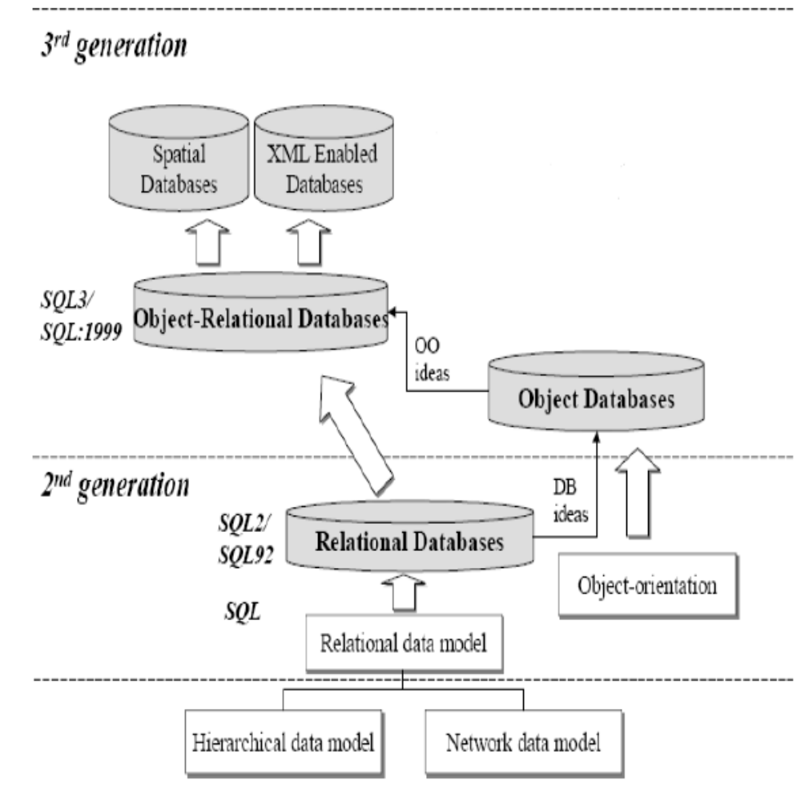
Evolution of DBMS

Slide 28
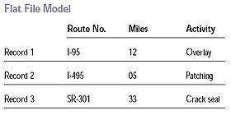
Flat Data Model (before 1960)
2-D array of data elements

Slide 29
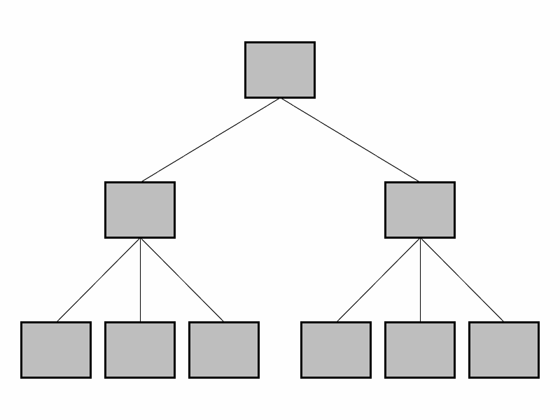
Hierarchical Model (1960)
Data is organized into tree like structure
Links describe nesting
Used in IBM’s IMS DBMS

Slide 30
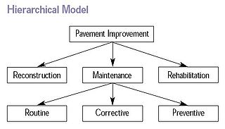
Example

Slide 31
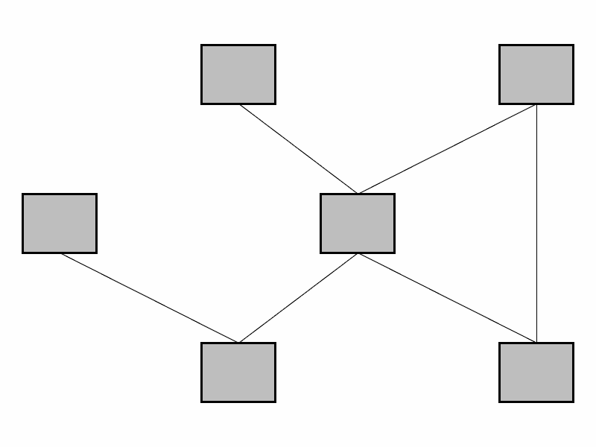
Network Model (1970)
Each record can have multiple parents and child forming lattice structure
Better than hierarchical model
IDMS (Integrated DMS)

Slide 32
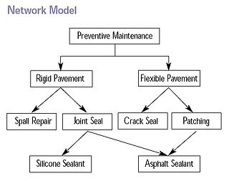
Example

Slide 33
Relational Model
Relational Model ( E.F.Codd 1969-70)*
  Relation is a table with rows and columns
  Every relation has a schema that describes the columns or fields
Relational model is good for:
  Large amounts of data —> simple operations
  Navigate among small number of relations
  Difficult Applications for relational model
    VLSI Design (CAD in general)
    CASE
    • Graphical Data
  *E.F. Codd (1970). A relational model of data for large shared data banks, Communications of the ACM, Vol 13. Issue 6(June 1970). pp.377-387
  Turing Award 1981 for his fundamental and continuing contributions to the theory and practice of database management system (Relational databases)

Slide 34
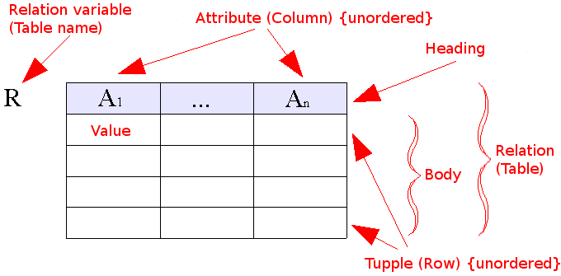
Relational Model (1980)
Data as set of tables
Having constraints and relationships
Oracle, DB2,Sybase

Slide 35
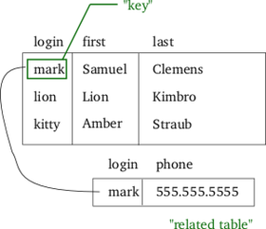

Slide 36

Object-Oriented & Object-Relational Data Model (1990)
Entities as objects, Grouped together as classes
Every class knows things, able to do certain things
Classes related to each other, Communicate through message passing
Complex SQL
UML is a language used to model data using OO model
Oracle9i, O2
ObjectStore, Versant

Slide 37
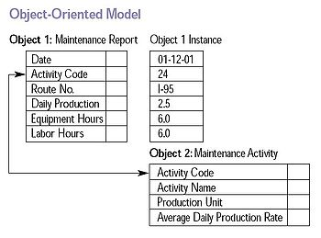

Slide 38
3rd Generation Data Models
XML Data Model (2005)
  Stores data in XML format
  Can be queried, exported, and serialized to desired format
  Oracle XML DB (10g), GmStone System’s Gemfire Enterprise
Spatial Data Model (2008)
  Stores data and answers queries related to objects in space
  Open Geospatial Consortium OGS
  Oracle Spatial, PostgreSpatial

Slide 39
Concept Based Models (present)
Syntax search
Semantic search
RDF, RDFS, OWL
Technology support

Slide 40
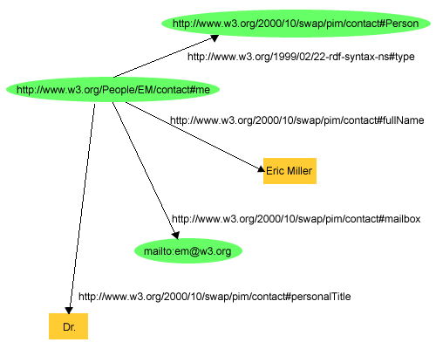
RDF Model

Slide 41
